Slide 1
10 steps to DevOps Part 8: Dev Test Labs
James Tramel
Developer Strategist
james.tramel@microsoft.com
Notes:
a

Slide 2
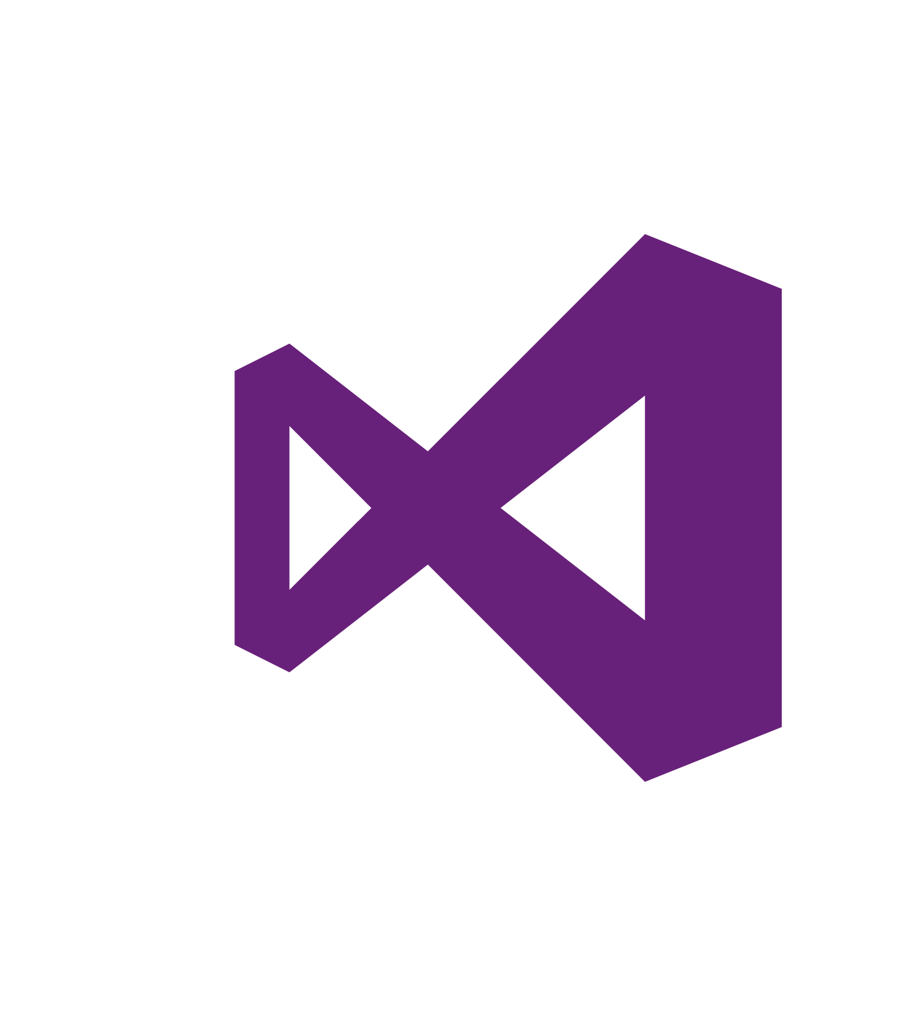
Every app Every Developer Every Platform
Visual Studio Online
Visual Studio
.NET
Notes:
The tool for everything. .net, sharepoint – web forms.
Mobile development - pokemon
Web Developer – notepad – web extensions
Javascript – typescript angular.
Talking Points
With the increase and diversity of devices there is an opportunity for developers to reach users where they are.
Also with the power of the cloud, infrastructure and capital expenditures no longer have to be a barrier to creating great applications.
Visual Studio 2015 bridges mobile and the cloud by being the first version built to target mobile-first and cloud-first development.

Slide 3
Software delivery challenges
?
Frustration
Delays
Lack of insights

Slide 4
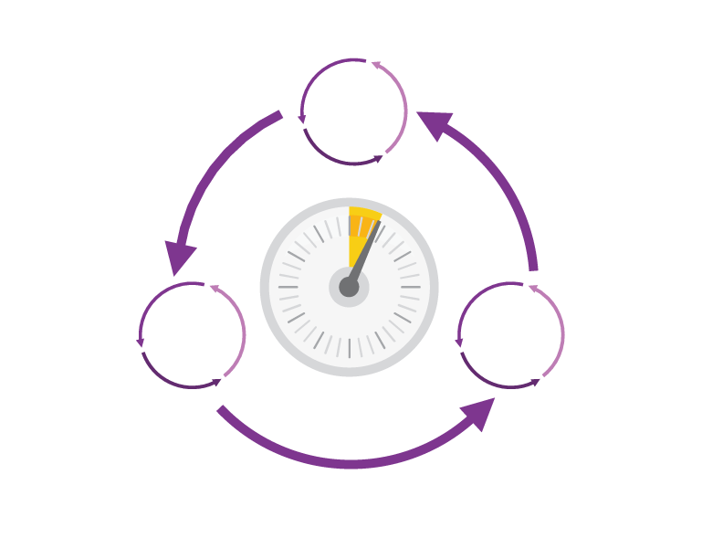
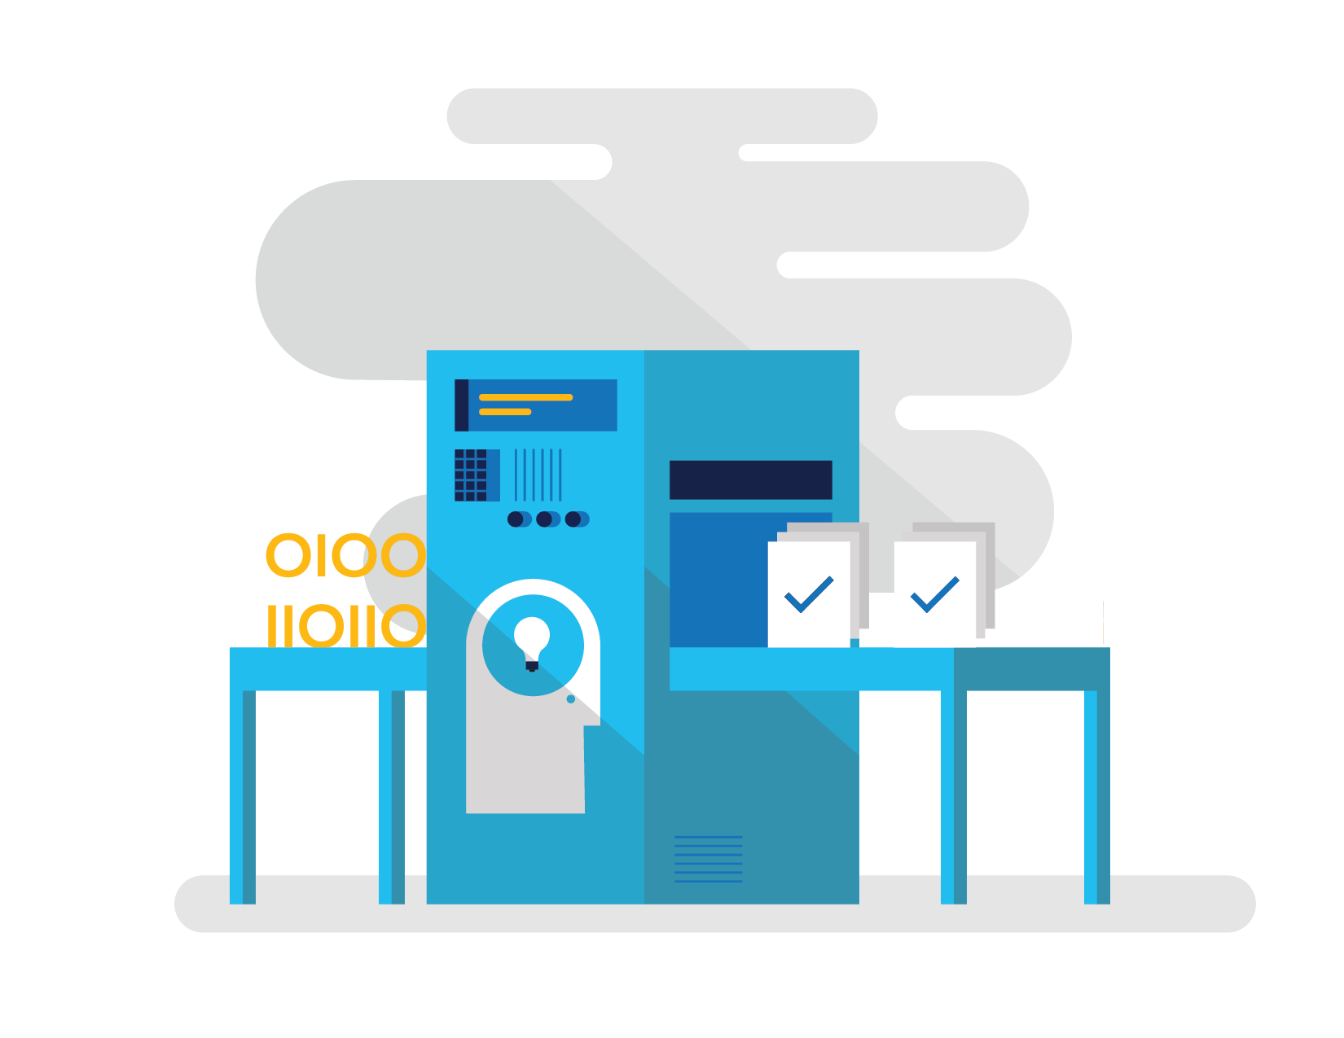
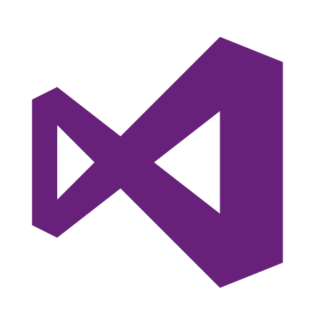
How Microsoft can help
Shorten Cycle Times
Optimize Resources
Improve Quality and Availablilty
Speed up and increase traceability of each release by empowering your development and operations teams with advanced collaboration and automation tools.
Efficiently manage environments using technologies that support self-service provisioning in a secure way, in line with your IT governance standards.
Capture rich telemetry on application performance and usage so that you can make better decisions on future investments and anticipate issues in production before they impact your service.
Visual Studio Team Services
Microsoft Azure
Visual Studio
Notes:
The Microsoft DevOps Solution provides a comprehensive set of software, cloud services, and other essential resources that help you deliver higher-quality software faster with less risk.
This solution is focused on addressing the most pressing challenges of the modern application lifecycle:
Shortening cycle times through advanced release management and automation tools
Optimizing resources and eliminating waste, and
Increasing quality and availability of your solutions

Slide 5






DevOps: the three components
DEV
OPS
1
People
2
Process
3
Products
Notes:
DevOps is the union of people, process, and products to enable continuous delivery of value to our end users.”\\
Focus today, from me, is process and products. Will focus on the how. The people is you. Be the change you want to see.

Slide 6
DevOps
1
4
Plan
Monitor + Learn
Development
Production
2
3
Develop + Test
Release

Slide 7
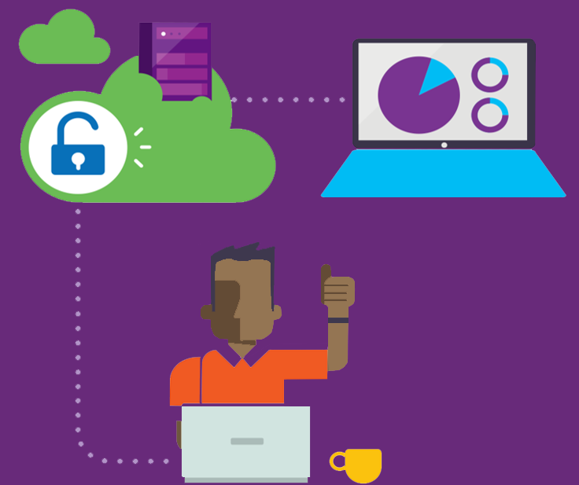



Visual Studio Enterprise – the tool for DevOps
Optimized for enterprise-class development
An integrated, end-to-end solution for teams of any size with demanding quality and scale needs. Take advantage of comprehensive tools and services for designing, building and managing complex enterprise solutions.
Greater productivity for enterprise application development and delivery
Plan, execute and monitor your entire quality effort, continuously
Manage complexity and close
the loop between Dev and Ops
Notes:
The tool for everything. .net, sharepoint – web forms.
Web Developer – notepad – web extensions
Javascript – typescript angular.

Slide 8
DevOps habits and practices
BACKLOG refined with LEARNING
MANAGED TECHNICAL DEBT
PRODUCTION FIRST MINDSET
INFRA-STRUCTURE is a FLEXIBLE RESOURCE
TEAM AUTONOMY & ENTERPRISE ALIGNMENT
EVIDENCE gathered in PRODUCTION
FLOW OF CUSTOMER VALUE

Slide 9
DevOps habits and practices
LEARN
Application Performance Management
Infrastructure as Code
Continuous Deployment
Release Management
Configuration Management
Automated Recovery
PLAN
Source Control
Stakeholder Feedback
Kanban
Bug Tracking
TEST
Application Performance Management
Usage Monitoring
Telemetry Collection Testing in Production
Stakeholder Feedback
APPROVE
Feature flags
Code Reviews
Automated Testing
Continuous Measurement
BACKLOG refined with LEARNING
MANAGED TECHNICAL DEBT
PRODUCTION FIRST MINDSET
INFRA-STRUCTURE is a FLEXIBLE RESOURCE
TEAM AUTONOMY & ENTERPRISE ALIGNMENT
EVIDENCE gathered in PRODUCTION
FLOW OF CUSTOMER VALUE
APP
Automated Testing
Code Review
Technical Debt
Continuous Integration
Continuous Deployment
Release Management
iNFRA
Automated Enviornment De Provision
Self Service Enviornment
Auotmated Recovery
MONITOR
Infrastructure as Code
Continuous Delivery
Release Management
Configuration Management
Automated Recovery
Testing in Production
Usage Monitoring
User Telemetry
Notes:
Automated Testing
Continuous Integration
Continuous Deployment
Release Management
Usage Monitoring
Telemetry Collection
Testing in Production
Application Performance Management
Infrastructure as Code
Continuous Delivery
Release Management
Change / Configuration Management
Automated Recovery
Load Testing
Avaialability Monitoring
Capactiy Management
Automated Enviornment De Provision
Self Service Enviornment
Auotmated Recovery (roll back / roll forward)
Stakeholder Feedback
Feature flags
Code Reviews / Technical Debt

Slide 10
Dev Ops Skill Katas
Modern Debugging
Automated Unit Testing and Architectural mapping
Work item / bug tracking / Continuous Test
Continuous deployment / integration
Infrastructure as code
Integrated testing / technical debt management
Continuous configuration / package management
Release management
Dev / test environments
Monitor and analyze
Notes:
Social club – intellitrace – works on anything .net
Taxation – intellitest and code maps
Sonar qube – vstsdemo – my shuttle 2 – myshuttle ci
https://sonarqube.com/, click rules
Package manager – parts unlimited – build – surreal engine – show feeds
Continuous integration – click on triggersin a build
Continuous deployment – parts unlimited
http://partsunlimited.azurewebsites.net/
Show deployment slots
Azurejut – dupont welcome -
Release – show Aramark azurejt
IAC – show github repo
Show create a new resource
https://github.com/Azure/azure-quickstart-templates
Dev test labs – en portal
Monitor and analytiz – so java portal or farkacam on my portal

Slide 11
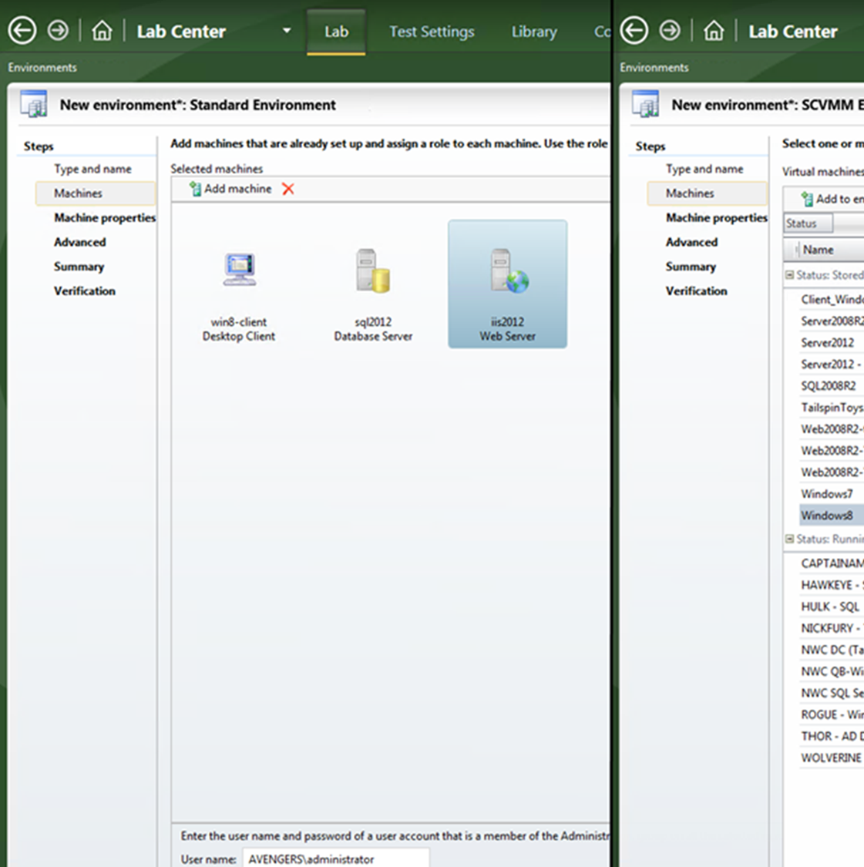
Lab Management
Dev/Test lab environments
Automate your virtual lab environment with Visual Studio Lab Management. Use templates to define and launch environment configurations for consistent testing. Quickly provision dev/test lab environments quickly for testers and developers.

Slide 12
Why Dev Test Labs?
Worry-free self-service
DevTest Labs makes it easier to control costs by allowing you to set policies on your lab - such as number of virtual machines (VM) per user and number of VMs per lab. DevTest Labs also enables you to create policies to automatically shut down and start VMs.+
Quickly get to ready-to-test
DevTest Labs enables you to create pre-provisioned environments with everything your team needs to start developing and testing applications. Simply claim the environments where the last good build of your application is installed and get working right away. Or, use containers for even faster and leaner environment creation.+
Create once, use everywhere
Capture and share environment templates and artifacts within your team or organization - all in source control - to create developer and test environments easily.+
Integrates with your existing toolchain
Leverage pre-made plug-ins or our API to provision Dev/Test environments directly from your preferred continuous integration (CI) tool, integrated development environment (IDE), or automated release pipeline. You can also use our comprehensive command-line tool.

Slide 13
Concepts
Artifacts
Artifacts are used to deploy and configure your application after a VM is provisioned.
Artifact repositories
Artifact repositories are git repositories where artifacts are checked in. Same artifact repositories can be added to multiple labs in your organization enabling reuse and sharing.+
Base images
Base images are VM images with all the tools and settings preinstalled and configured to quickly create a VM.
Formulas
Formulas, in addition to base images, provide a mechanism for fast VM provisioning.
Caps
Caps is a mechanism to minimize waste in your lab. For example, you can set a cap to restrict the number of VMs that can be created per user, or in a lab.+
Policies
Policies help in controlling cost in your lab. For example, you can create a policy to automatically shut down VMs based on a defined schedule.+
Security levels
Security access is determined by Azure Role-Based Access Control (RBAC). To understand how access works, it helps to understand the differences between a permission, a role, and a scope as defined by RBAC.

Slide 14
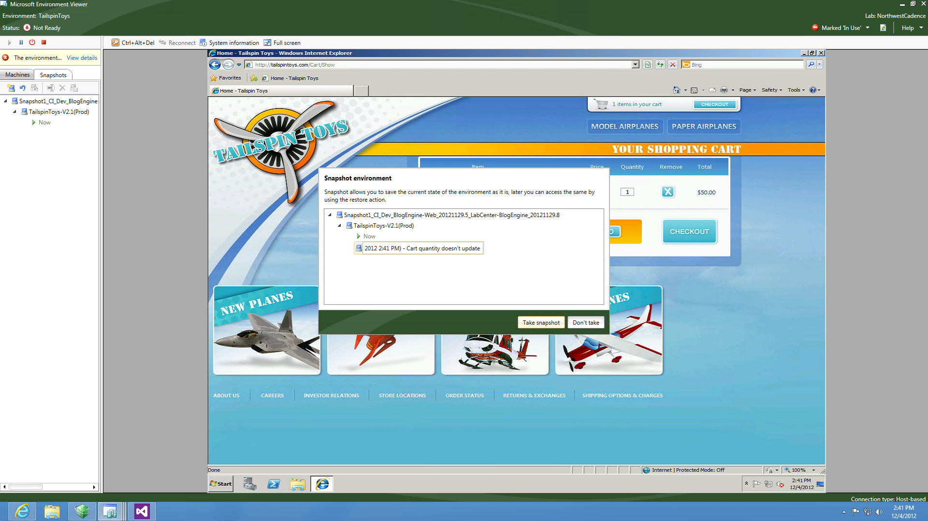
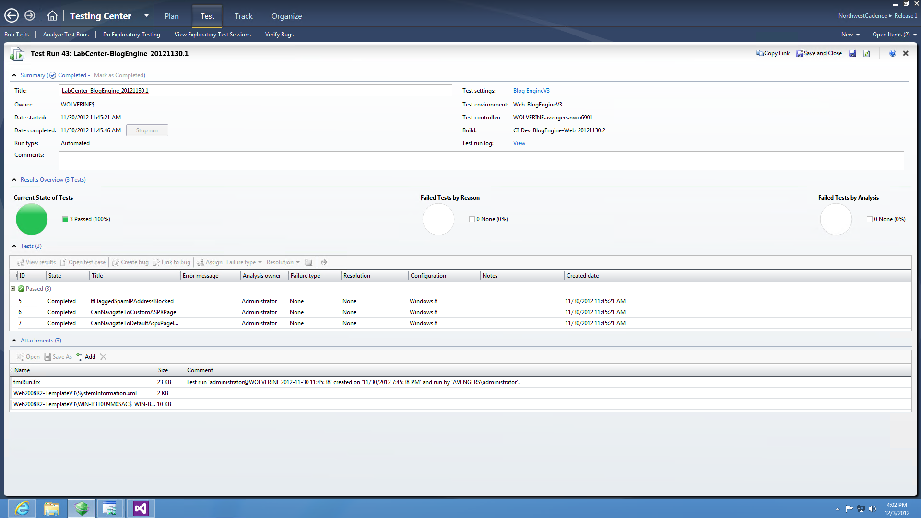
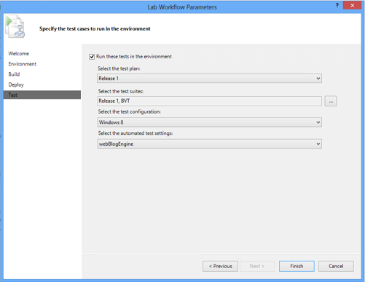
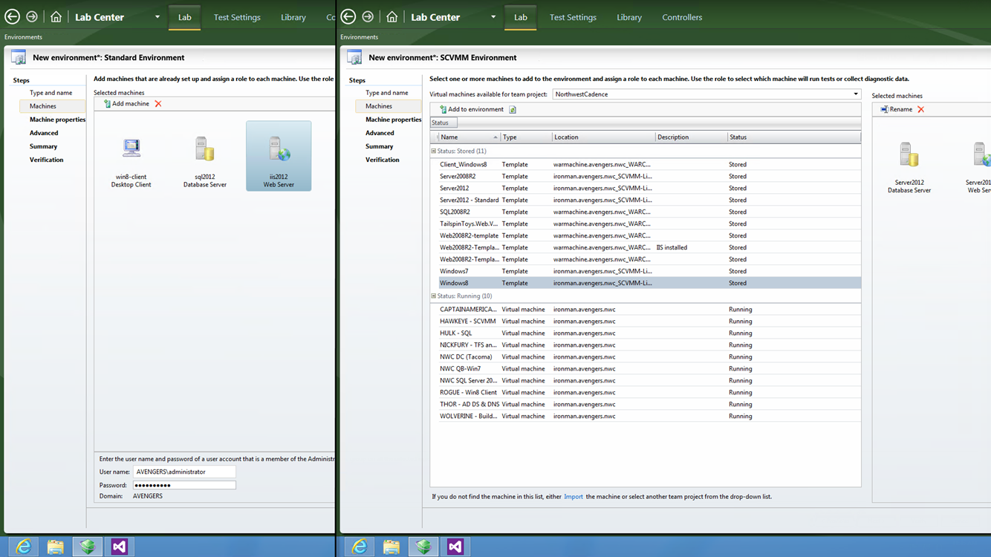
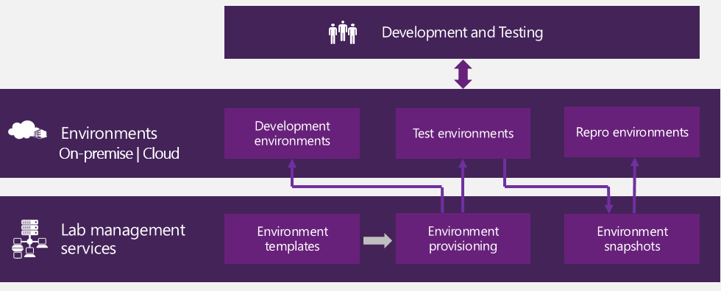
Lab Management
Spin up virtual test environments from within Test Manager, or attach a virtual environment to a manual testing session
Continuous Build-Deploy-Test
Test Automation
Environment Management
Intelligent Analysis
Snapshot environments during manual testing to increase reproducibility
Notes:
A lab management automation solution reduces the cycle times to manage and provision the test environments needed to enable continuous acceptance testing. A lab management automation solution should include capabilities to:
Store and manage baseline templates for the needed test environments
Provision environments on demand using the environment templates
Provision environments to on-premise bare metal, private cloud, and public cloud infrastructures
Snapshot environments when defects are encountered and needed to be reported
Provision environments from snapshots to enable defect reproduction and resolution
Environments supported include:
On-premise self management environments
On-premise virtualized environments managed using SCCM
Talk Track:
Lab Center lets you create and manage your testing environments from a single location. Environments can be stored on local metal, or virtualized on site or in the cloud. Maintain multiple realistic environments so that your application can be quickly deployed and tested under the configurations you expect your users to use.
Environments can be based on self-managed infrastructure or virtualized infrastructure managed using SCCM (System Center Configuration Manager)
Talk Track:
With Lab Manager, your build and deployment cycle times can be reduced in step with your development and testing cycle times. Automating your build and deployment pipeline will reduce manual errors, decrease cycle times, and increase quality.
Talk Track:
Whether it is bare metal machines, or multi-part SCVMM environments, Lab Manager helps you manage your test environments from a single location. Testers can quickly find the right environment to test on, reducing hand-off times and decreasing manual deployment defects. The ability to take environment snapshots when bugs are found significantly reduces the likelihood of “no-repro” errors.
Enable data collectors and generate detailed test results to ensure any bugs that are found are actionable.
Team Foundation Server keeps track of all the pieces, keeping your entire team on the same page and reducing time to repair.
m interaction.

